Slide 1
Object Model for Live Actor and Entity in a MAR world
Kwan-Hee Yoo
ISO/IEC JTC 1 SC24 WG9 Meeting
2015. 8. 24
Chungbuk National University

Slide 2
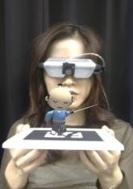
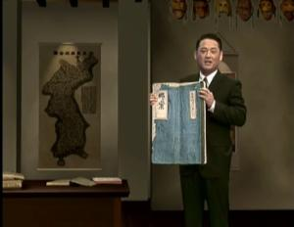
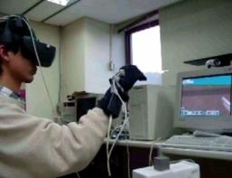
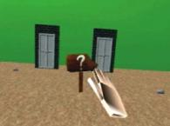
Augmented Reality Continuum
Mixed Reality
Real
Environment
Augmented
Reality
Augmented
Virtuality
Virtual
Environment
HITLab
KBS
[Paul Milgram’s Reality-Virtuality Continuum (1994)]

Slide 3
System Framework for representing LAEs in a MAR world
Physical world
User
Sensors
(2D/3D camera, GPS, Gyro, etc)
Recognizer/
Tracker
Renderer/
Simulator
Spatial Mapper
Display/
UI
Event Mapper
MAR Scene
(spatial scene, events, targets, etc)

Slide 4
Live Actor and Entity in a MAR world
In a Real World
In a MAR World
-How to sense LAEs in real world
-Need to model objects for LAEs

Slide 5
Characteristics of Live Actor and Entity in a MAR world
-A LAE should be extracted from an image captured by a camera in a real world
2D chromakeying image
3D skeleton
-The extracted LAE can be moved freely in a MAR world through Spatial mapper
and also can be used to control its event.
Modeling objects for representing the live actor and entity

Slide 6
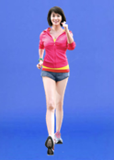
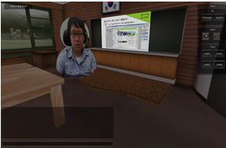
Consider Live Actor and Entity
-represent live actor and entity as 2D chromakeying image
-represent a single live actor and entity
-texture mapping data over 3D virtual human object
-represent 3D skeleton for live actor and entity
-motion control of 3D virtual human object by
the extracted skeleton

Slide 7
Characteristics of Live Actor and Entity
-Types for representing live actor and entity
: 2d chromakeying image
: 3D human object with 2d chromakeying image
: 3D skeleton
-Motion of live actor and entity
: location
: direction
: calibration control
-Events activated by live actor and entity
: types
: outputs

