Slide 1
File Format for MAR Live Actor and Entity Representation
Kwan-Hee Yoo
ISO/IEC JTC 1 SC24 WG9 Meeting
2015. 7. 9
Chungbuk National University

Slide 2
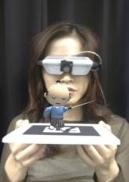
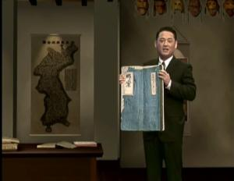
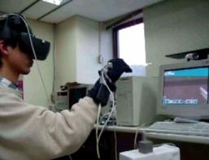
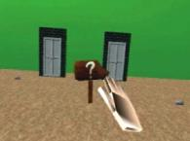
Augmented Reality Continuum
Mixed Reality
Real
Environment
Augmented
Reality
Augmented
Virtuality
Virtual
Environment
HITLab
KBS
[Paul Milgram’s Reality-Virtuality Continuum (1994)]

Slide 3
System Framework for representing LAEs in a MAR world
Physical world
User
Sensors
(2D/3D camera, GPS, Gyro, etc)
Recognizer/
Tracker
Renderer/
Simulator
Spatial Mapper
Display/
UI
Event Mapper
MAR Scene
(spatial scene, events, targets, etc)

Slide 4
Sensing Node
RCSensingDeviceNode
{
SFString[in] id “”
SFString[in] description “”
SFString[in] type camera //
SFFloat[in] fov 45.0
SFInt [in] framerate 20 // 초당 프레임 수
SFImage[out] image 0 0 0 // 캡쳐 이미지 좌표 값
MFString[in] jointypes “” // 조인트 포지션의 이름(H-Anim)
MFVector[out] values 0 0 0 // 조인트 포지션 깊이 좌표 값
SFBool[in] usedChromakeying false //크로마 킹 여부(true, false)
}

Slide 5
Bounding Box Node for Real World
RCBBRSNode
{
SFString[in] id “”
SFString[in] description “”
SFVector[in,out] startpoint 0 0 0
SFVector[in,out] endpoint 320 240 0
RCSensingDeviceNode[in] sensingDevice “”
}

Slide 6
Bounding Box Node for Virtual World
RCBBVSNode
{
SFString id “”
SFString description “”
SFVector[in, out] startpoint 0 0 0
SFVector[in, out] endpoint 1 1 1
SFString[in] virtualspace null // 가상공간 오브젝트 로드
SFVector[out] vsStartpoint 0 0 0
SFVector[out] vsEndpoint 1 1 1
}

Slide 7
Spatial Mapper
RCSpatialMapper
{
SFString id “”
SFString description “”
RCBBRSNode[in, out] realspace “”
RCBBVSNode[in, out] virtualspace “”
SFVector[in, out] direction 0 0 1
SFVector[in, out] scale 1 1 1 // 크기조절
SFVector[in, out] up 0 1 0
SFBool[in] usedCollision false
SFString[in, out] vcObject Null
}

Slide 8
Interaction: Event Mapper
Type1: camera
Type2: object
Type3: AR content

Slide 9
typedef struct Data{
voice,
joint,
AR,
….
} userdata; // data of real character
void stateCheck(); // Check state
void inputdataAnalysis(userdata dt); // input data를 scripDB에 넣어 분석
void detectEvent(); // inputdata_analysis에서 분석한 내용을 eventDB에 넣어 event를 판단, 여기
서 해당 data가 voice인지, gesture인지, AR인지 판단하여 id 값과 분석
data를 Event control function에 넘김
void eventControl() ; // detect_event()에서 넘겨받은 id와 data를 기반으로 해당 DB를 찾아가
Function Controller을 색출함
void controlExecution(); // 검출된 Function Controller를 실행하여 real character의 inputdata에 해당하는 Event를 execution 함

Slide 10
Event Executer
Event Class : camera, object, AR content which can be interacted by event of real human character
Event Callback Functions:
Callback Functions for interacting camera, object and AR content
Event
Class
EventExecuter
Function
Picking
Function
Right
Function
Left
Function
…
EventExecuter
executeCommand
Switch
(EventCommand)
NONE
Function
Delegate
PICKING
Function
Delegate
LEFT
Function Delegate
RIGHT
Function Delegate
UP
Function Delegate
DOWN
Function Delegate
ZOOMIN
Function Delegate
ZOOMOUT
Function Delegate

Slide 11
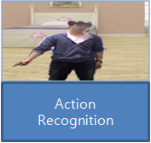
Recognized Event Types
SENSOR_HELD
IMAGE_XXX
GESTURE_XXXX_XXXX
– Hand, Foot, Arm, Leg,
Face, Eye, Full body
VOICE_XXX
-KOR, ENG, JPN
Events

Slide 12
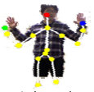
Action Types
HELD_SENSOR_
GESTURE_XXXX_XXXX
– Hand, Foot, Arm, Leg,
Face, Eye, Full body, image
VOICE_XXXX_XXXX
etc
Gesture Events
P2
point
image
skeleton
vector
P1
P= (x,y,z)
P1=(x1,y1,z1)
P2=(x2,y2,z2)

Slide 13
Gesture Events
P2
Posture
point
image
skeleton
vector
P1
P= (x,y,z)
P1=(x1,y1,z1)
P2=(x2,y2,z2)
Gesture
X_POS, X_NEG
Y_POS, Y_NEG
Z_POS, Z_NEG
X_WAVE
Y_WAVE
Z_WAVE
CW(CLOCKWISE)
CCW(COUNTER CLOCKWISE)

Slide 14
Gesture Events Types
Action | Objects | Move | Definition of action types
Gesture | Left hand(LH) | The x positive direction | GESTURE_LH_X_POS
 | Right hand(RH) | The x negative direction | GESTURE_RH_X_NEG
 | Left foot(LF) | The y positive direction | GESTURE_LF_Y_POS
 | Right foot(RF) | The y positive direction | GESTURE_RF_Y_POS
 | Left Lower Arm(LLA)
 | Left Arm(LA)
 | Right Lower Arm(RLA)
 | Face(F)
 | Eye(E)
 | Full body(FB)

